Slide 1
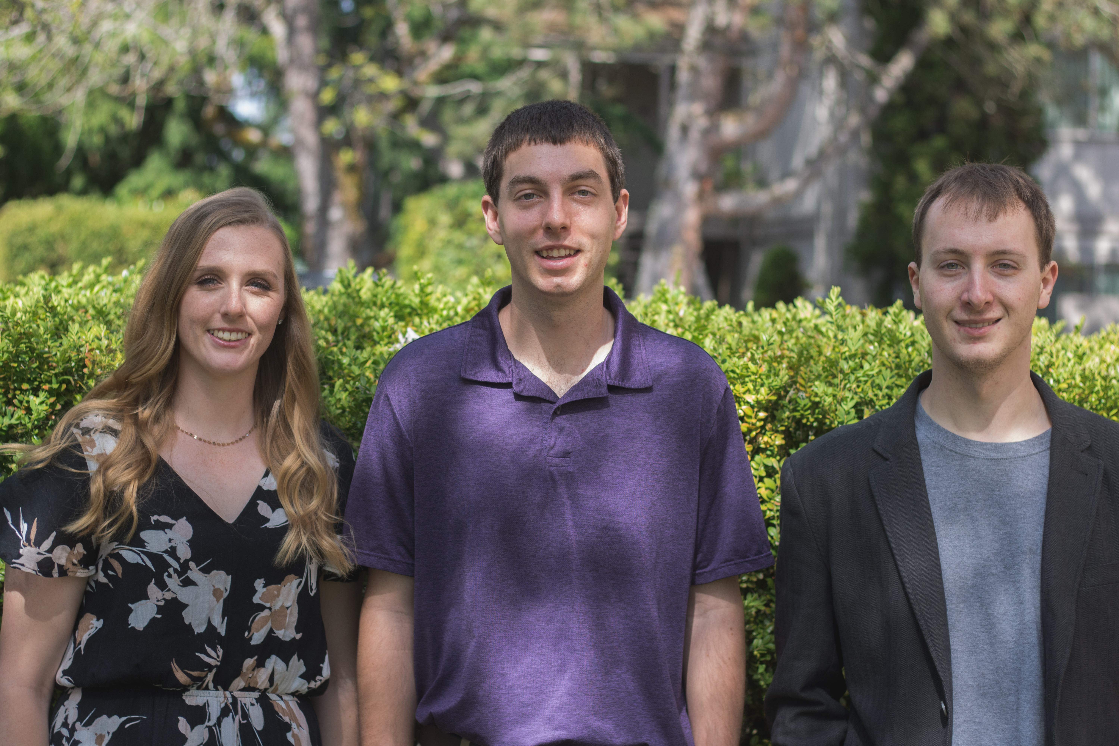
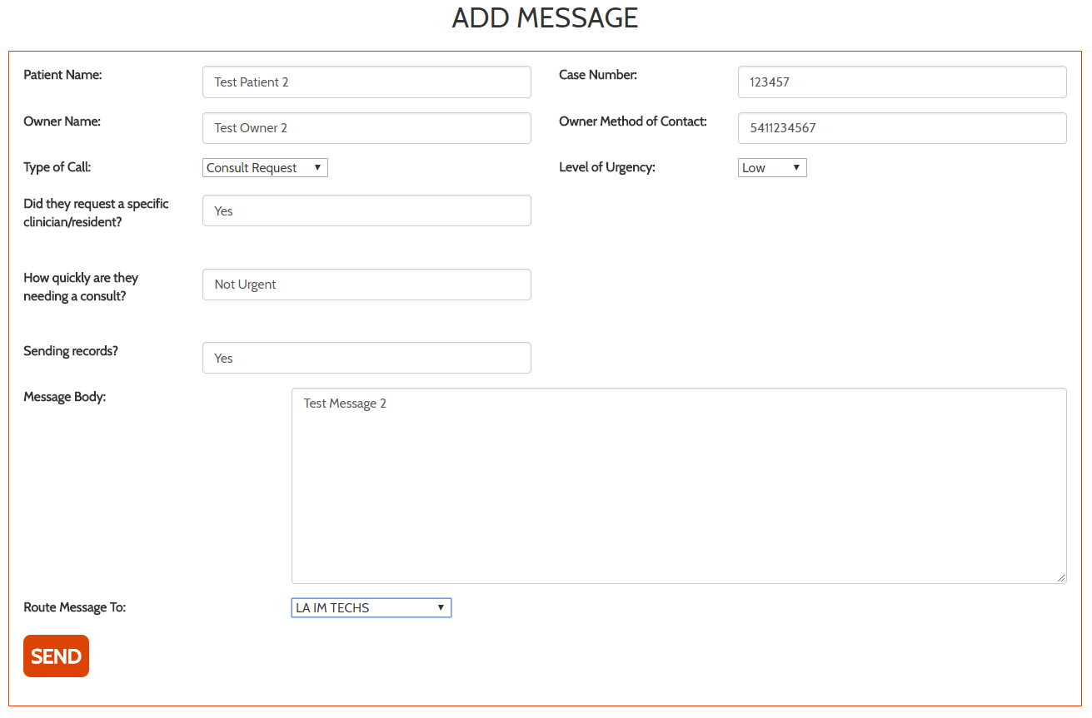
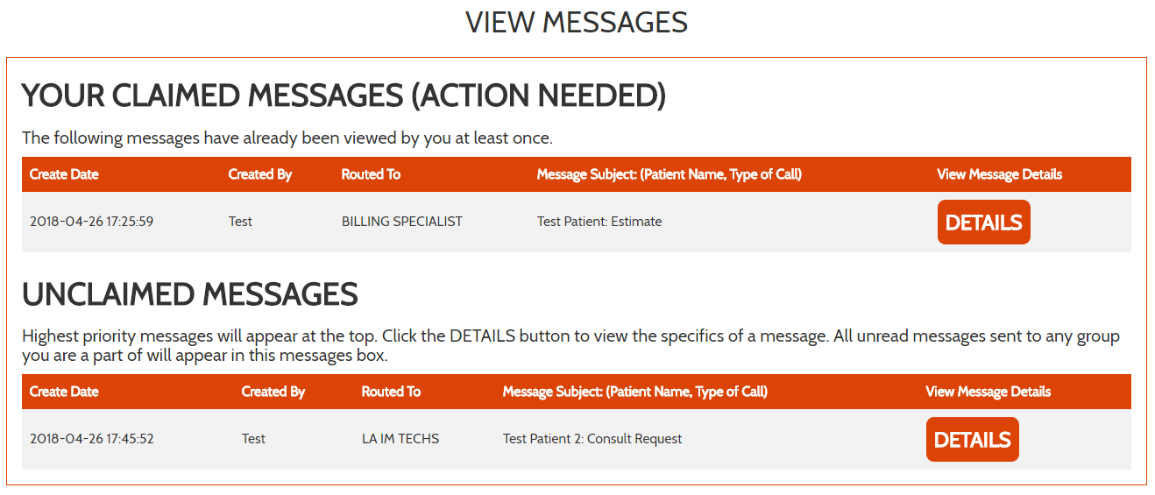
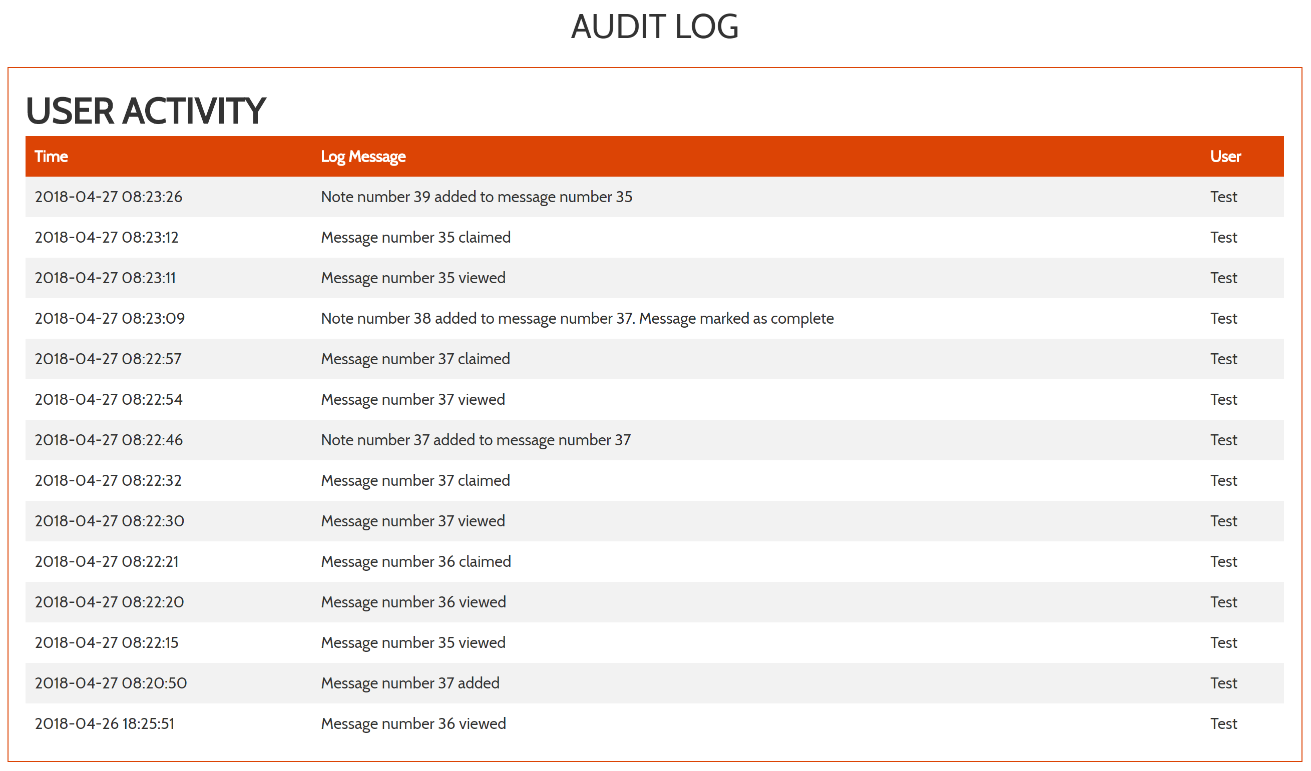
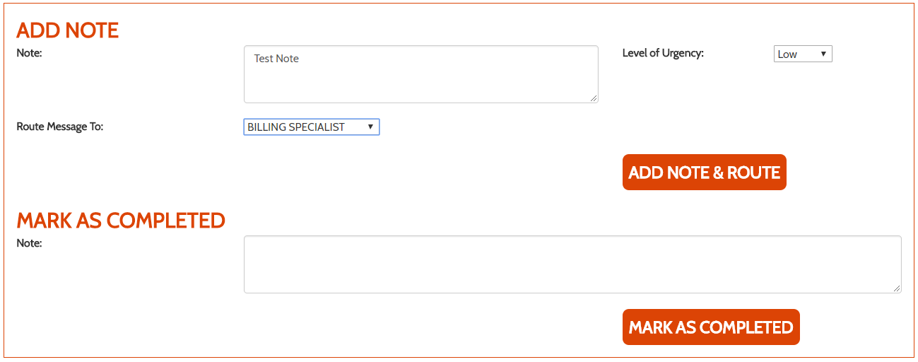
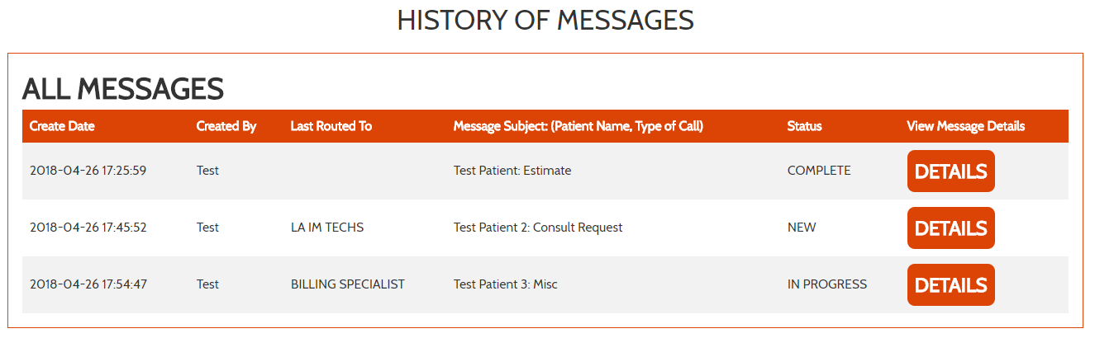
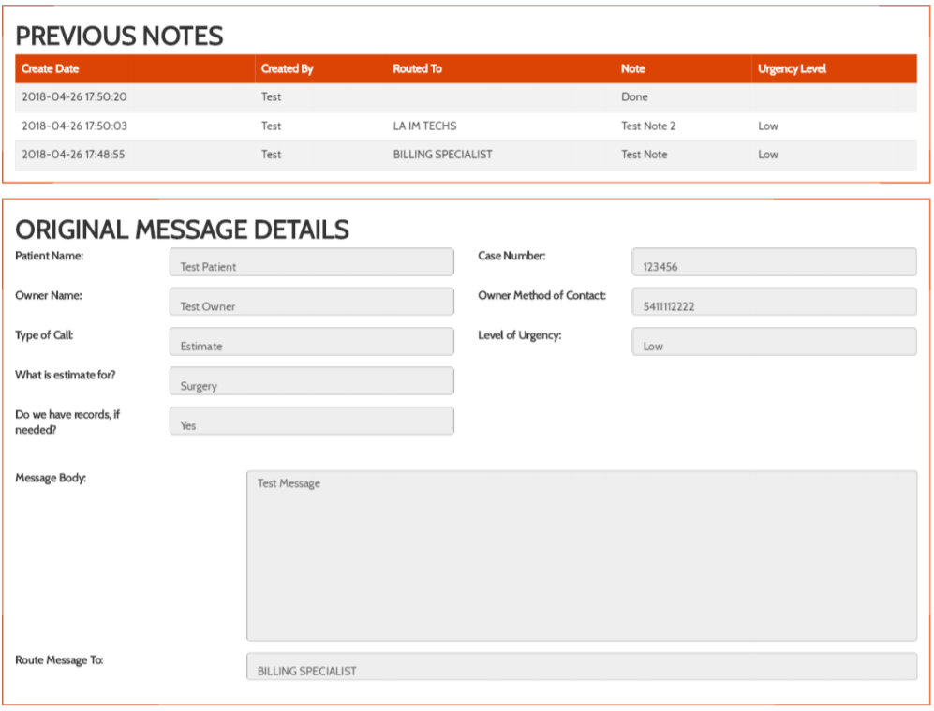
39
Introduction and background
Connectbasket
Having an efficient and easy-to-use software system for managing operations is integral for any company, and the Oregon State University Veterinary Hospital is no exception. The current software used by the hospital to manage their daily operations is decades old and doesn’t allow efficient communication within the hospital. This software causes many unnecessary errors and patient and owner suffering that could be avoided with a better system. The hospital needs a new software package that will not only provide a system that doesn’t hinder workflow, but will improve it and allow for increased efficiency.
Software to help improve pet care at the OSU Veterinary Hospital by streamlining internal hospital communication
Pictured from left to right:
Kailyn Hellwege, Henry Fowler, Taylor Kirkpatrick
Project Client:
Dr. Chinweike Eseonu
Affiliation:
Oregon State University Veterinary Hospital
Contact Information:
fowlerh@oregonstate.edu
hellwegk@oregonstate.edu
kirkpatt@oregonstate.edu
Project goals
Allow users to create messages containing information such as case number, message category, level of urgency, patient name, and owner name and contact information
Allow messages to have a status to tell whether they are new, in progress, or complete
Allow messages to be routed to a group of users
Allow notes to be added to messages
Allow users to have profiles where they can select or change their group membership
Provide an audit log that shows user actions such as creating, viewing, or claiming messages
Increase the overall efficiency of messages being transported throughout the hospital
Reduce the amount of paper being printed
Reduce errors in the communication process of the hospital
Add message page
View messages page
Results
ConnectBasket users can view a history of all messages that are marked as new, in progress, or completed, and view details of the messages. Completed messages are read-only and no further notes can be added.
Audit log page
Add note page
Project description
Project outcomes
In order to accomplish the goals of this project, the ConnectBasket website was created. The website provides a platform for hospital employees to log in and access several features such as creating, editing, and viewing messages.
The website is hosted using an Apache web server running on a Linux Ubuntu server operating system. The data for our website is stored in a MySQL database and PHP was used for interaction between the website and the database. The front end of our website was made using the AngularJS framework along with HTML and CSS.
We chose to create a website for our project because the users wanted to be able to access the project from desktop computers and mobile devices, and a website was the best way provide that in the time available for the project.
Using a digital solution will provide the hospital with a decreased use of paper and ink, as well as providing a better system for communicating quickly back and forth across the hospital.
The new system will provide a way for administrators to make sure the proper workflow is being followed by employees. They will be able to see when messages are being viewed or claimed with no action being taken and correct any mistakes that are being made for the future.
Having access from mobile devices allows employees to be quicker in responding to messages providing faster and better care for pets.
After a message has been completed, it can be exported as a pdf file that contains all of the original message information as well as all of the notes that have been added to the message.

